Slide 1
HealthConnect Clinic
Data Analytics Contribution
Project: HealthConnect Clinic Support Using Data and AI
Track: Data Analytics
Dataset: 5,000 appointment records
Objective:
Analyze appointment data to identify patterns associated with missed appointments and provide evidence-based insights to support better appointment management and patient support.
Main Deliverable:
Validated Power BI Dashboard + Analytical Findings & Recommendations

Slide 2
Key KPI — Overall No-Show Rate
48.46%
Overall No-Show Rate
2,423 out of 5,000 appointments were recorded as no-shows.
Appointment Outcomes
No-Show: 2,423 — 48.46%
Attended: 2,314 — 46.28%
Cancelled: 263 — 5.26%
Key Message
Almost half of the appointments in the analyzed dataset were recorded as no-shows, making missed appointments an important operational issue for HealthConnect Clinic.
Validation: Power BI result independently checked against Excel during Week 7.

Slide 3
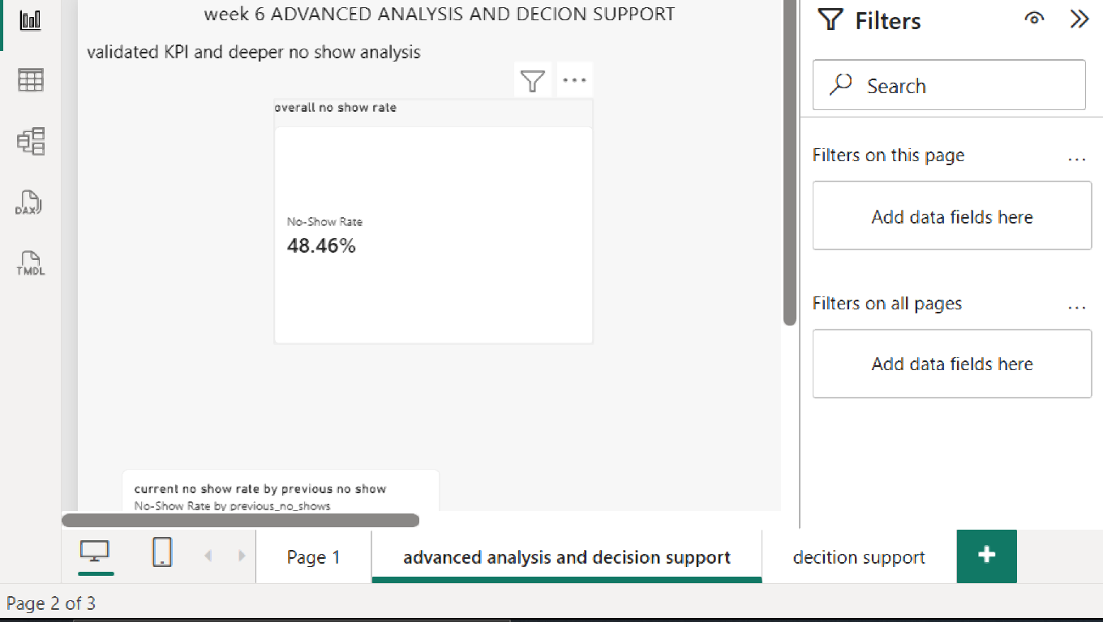
Overall No-Show Rate

Slide 4
Slide 1 — Overall No-Show Rate
finding:
The overall no-show rate is 48.46%, meaning almost half of the recorded appointments resulted in a no-show.
Why it matters:
Missed appointments are a significant issue for HealthConnect Clinic and may affect clinic efficiency, patient support and the use of available appointment capacity.
Recommended Action
HealthConnect should focus on early identification of patients at higher risk of missing appointments and use targeted reminders and follow-up support to reduce no-shows.

Slide 5
Key No-Show Patterns
1. Booking Lead Time
No-show rates increased as appointments were booked further in advance:
0–7 days: 27.81%
8–14 days: 33.55%
15–30 days: 43.21%
30–60 days: 60.49%
2. Previous No-Show History
Patients with previous no-show history showed higher subsequent no-show rates.
3. Reminder Status
Reminder sent: 47.36%
No reminder: 51.39%
Difference: 4.03 percentage points
Key Finding
Booking lead time and previous no-show history showed important associations with missed appointments, while reminder activity was associated with a lower no-show rate.

Slide 6
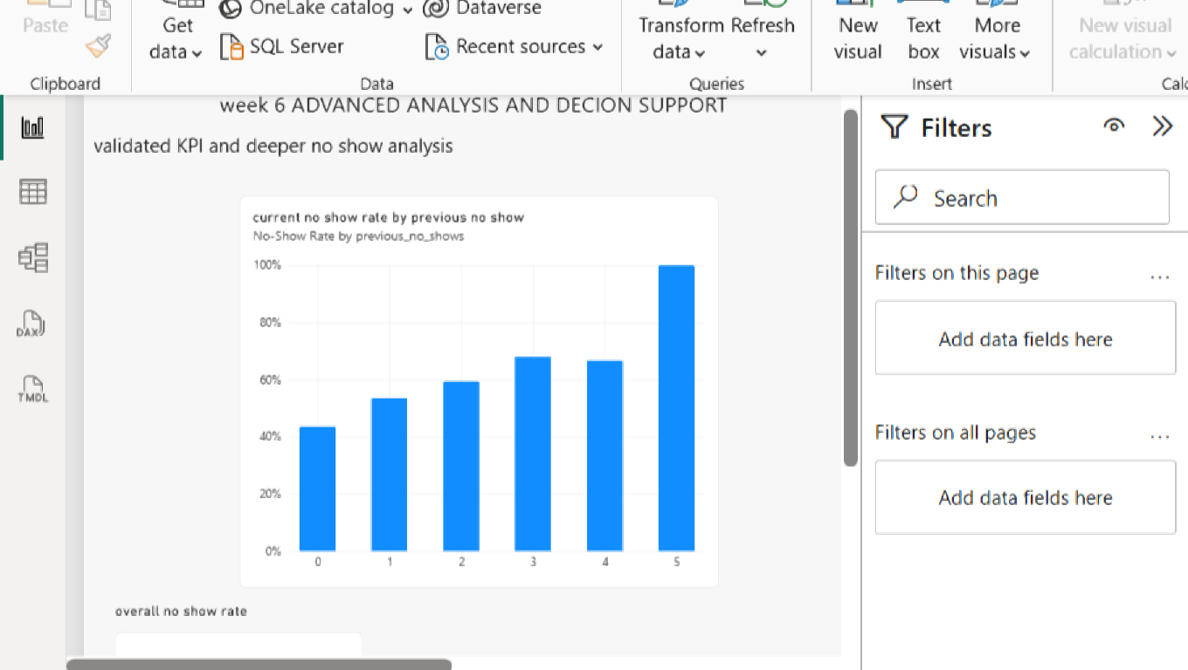
Previous No-Show History

Slide 7
slide 2 — Previous No-Show History
Finding:
Patients with a history of previous no-shows had higher current no-show rates. The rate increased from 43.5% for patients with no previous no-shows to approximately 61% for patients with two or more previous no-shows.
What this means
Previous attendance behavior can be used as an important indicator when identifying patients who may need additional appointment support.
Recommended Action
HealthConnect could use previous no-show history to provide targeted reminders and follow-up support for patients with repeated missed appointments.

Slide 8
slide 3 — Booking Lead Time and Reminders
finding:
No-show rates increased as the time between booking and the appointment became longer. The highest no-show rate was for appointments booked 31–60 days in advance.
Reminder messages were associated with slightly lower no-show rates across the lead-time groups.
What this means
Patients with appointments booked further in advance may need additional reminders because there is more time for plans to change or appointments to be forgotten.
Recommended Action
HealthConnect should consider earlier and follow-up reminders, particularly for appointments booked several weeks in advance.

Slide 9
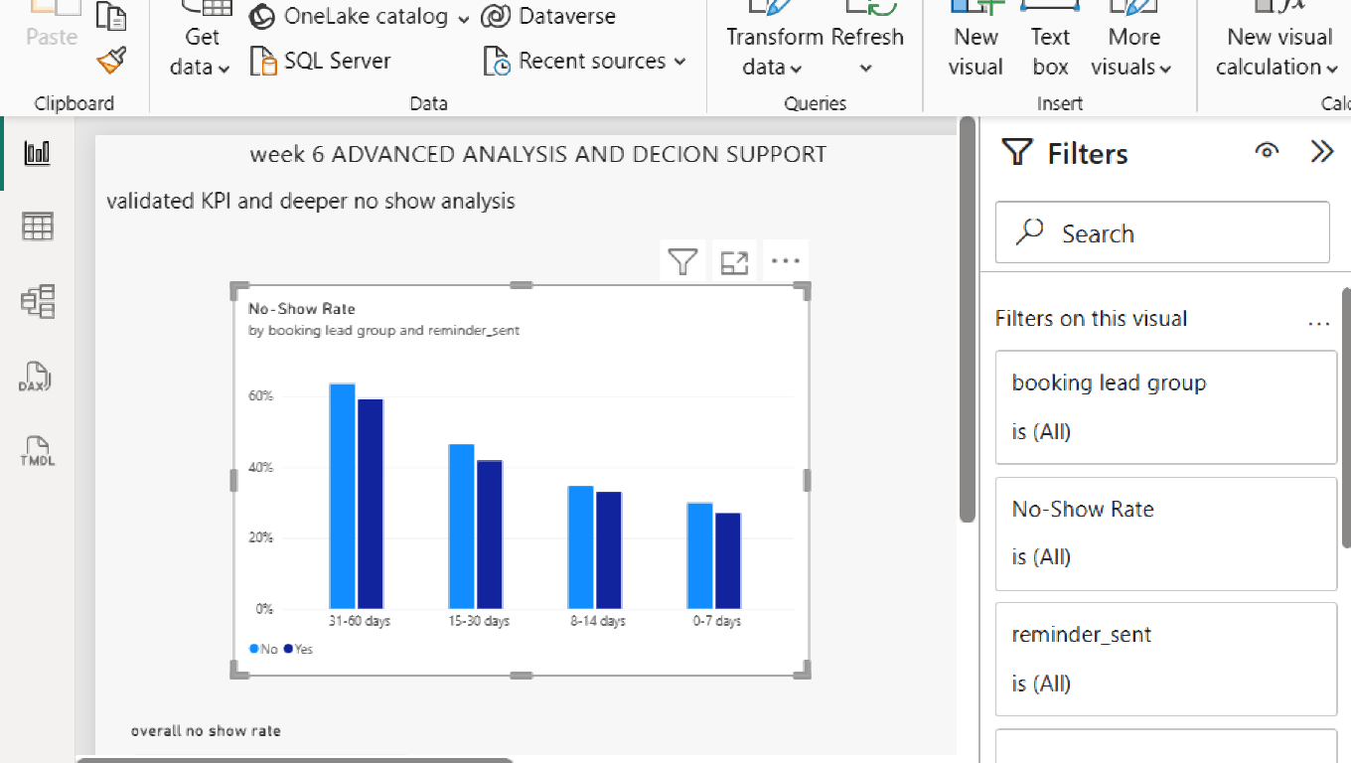
slide 3 — Booking Lead Time and Reminders

Slide 10
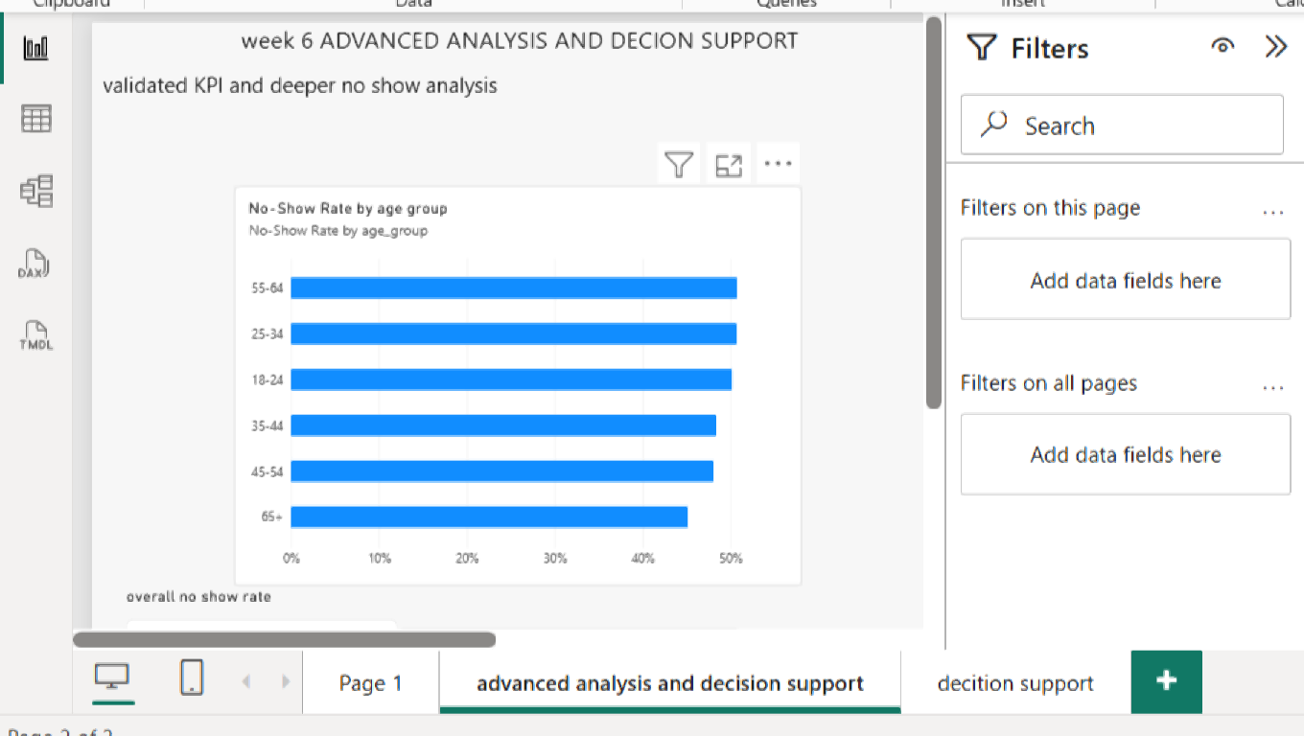
Slide 4 — No-Show Rate by Age Group

Slide 11
Slide 4 — No-Show Rate by Age Group
Finding:
No-show rates were relatively similar across most age groups, ranging from approximately 45% to 51%.
The 65+ age group had the lowest no-show rate at 45.12%, while the 55–64 age group had a higher rate of 50.75%.
What this means
Age alone does not show a strong enough pattern to be the main factor for predicting missed appointments.
Recommended Action
HealthConnect should avoid relying on age alone when identifying patients who may miss appointments. Other factors, particularly previous no-show history and booking lead time, should receive greater attention.

Slide 12
Business Insights & Recommendations
What the Data Shows
Missed appointments represented 48.46% of the analyzed appointments.
Longer booking lead times were associated with higher no-show rates.
Previous no-show history was associated with higher future no-show rates.
Appointments with recorded reminders had a lower no-show rate than appointments without reminders.
Recommended Actions
1. Monitor No-Show KPIs
Use the Power BI dashboard to regularly monitor appointment outcomes.
2. Strengthen Follow-Up
Consider additional reminders for appointments booked further in advance.
3. Priorities Higher-Risk Appointments
Use previous appointment behavior as one factor when prioritizing follow-up.
4. Use Data for Decision Support
Combine the analytics findings with the predictive modelling work to support proactive appointment management.
Business Value
Better use of appointment data → targeted follow-up → improved appointment management

Slide 13
Week 7 → Week 8 Transition
Main Week 7 Output
Validated the HealthConnect Data Analytics dashboard, KPIs and key no-show findings.
Testing Result
The overall no-show rate and key analytical results were checked against independent Excel calculations and were consistent.
Issue Identified
Very high percentages in smaller groups require caution because small sample sizes can affect interpretation.
Refinement
Added clearer interpretation guidance and strengthened the validation of key dashboard outputs.
Ready for Integration
The validated analytics findings and dashboard outputs are ready to support the final HealthConnect solution.
Still to Integrate
The analytics findings need to be connected with the Data Science, ML Engineering, Gen AI and Project Management components.
Final Presentation Goal
Demonstrate how validated analytics findings contribute to the integrated HealthConnect decision-support solution.

Slide 14
Testing & Validation
What was tested
Overall no-show rate
Key Power BI calculations and visuals
Dashboard interactions and filters
Week 6 findings against independent Excel calculations
Result
The validated calculations matched the independent Excel results, and no calculation errors were identified in the tested measures.
Refinement
A caution was added that very high percentages in small groups should be interpreted carefully because smaller sample sizes can produce unstable results.
Outcome
The Week 7 testing confirmed that the main analytics outputs were consistent and suitable for use in the HealthConnect decision-support process.

Slide 15
Data Analytics + Data Science Integration
Data Analytics → Data Science
How the tracks connected
The validated Data Analytics findings helped inform the Data Science modelling work.
Key analytical findings included:
Previous no-show history was strongly associated with future no-shows.
Reminder-related patterns were identified in the appointment data.
Data Analytics testing helped identify and address an inappropriate feature assumption.
These findings contributed to the selection and interpretation of model features.
Data Science Contribution
The final Data Science component is a Logistic Regression model that estimates the likelihood that an appointment will result in a no-show.
The model is intended to support proactive follow-up before an appointment, rather than making automatic decisions about patients.

Slide 16
Data Science → ML Engineering
Data Science provides:
The final model specification
Required preprocessing
Model input requirements
Probability output
Recommended 0.35 decision threshold
Data-leakage exclusions
Business Connection
Data Analytics: What is happening?
↓
Data Science: Can we predict which appointments may be at higher risk?
↓
ML Engineering: How can the validated model be integrated into a usable workflow?
↓
HealthConnect: Support targeted follow-up before appointments.

Slide 17
final Integration Readiness — Data Analytics
Final Component
HealthConnect Final Analytics & Decision Support Package
Problem Addressed
Understanding and reducing missed appointments through validated data insights and decision support.
Current Status
The Power BI dashboard, KPIs, key findings and recommendations have been tested, validated and refined.
Week 7 Improvements
Validated key figures against independent Excel calculations.
Tested dashboard interactions.
Added caution around results from small groups.
Refined interpretation of important findings.
Dependencies
Data Analytics provides validated findings to Data Science and business insights to Project Management.
Output Provided
Final dashboard, validated KPIs, key visualisations, findings, recommendations and analytical limitations.
Evidence of Readiness
Validated Excel calculations, Power BI dashboard, testing evidence and Week 7 refinement work.
Remaining Limitation
The analytics findings show associations and should not be interpreted as proof of causation. Final end-to-end integration depends on the other HC-POD components.

Slide 18
Final integration and conclusion
Data Analytics
Identified key patterns associated with missed appointments and provided validated KPIs and insights.
Data Science
The identified factors can support investigation of a predictive approach for identifying patients who may be at higher risk of missing appointments.
Business / Clinic Support
The insights can support targeted reminders, follow-up and proactive appointment management.
End-to-End Value
Data → Analysis → Insights → Predictive Support → Action
Conclusion
HealthConnect can use its appointment data to better understand missed appointments, support proactive follow-up and improve appointment management.
Next Step: Continue testing and validating predictive approaches before operational use

Slide 19
Limitations & Risks
Data Analytics
The analysis identifies associations, not causation.
Some categories have smaller sample sizes, so percentages should be interpreted with caution.
Missing values were present in some fields, including distance and waiting-time information.
Data Science
The predictive model should support human decision-making, not make automatic decisions about patients.
Prediction performance may be less reliable for patients with limited or no previous appointment history.
waiting_time_minutes must not be used as a predictive input because it is recorded after the appointment and creates data leakage.
Overall HealthConnect Solution
The solution is a decision-support approach and does not replace appropriate human oversight.
Further monitoring and validation would be required before operational deployment.

Slide 20
HC-POD Final Integration
. Data Analytics
Identifies attendance patterns, validates KPIs and provides business insights.
↓
2. Data Science
Uses validated findings to develop a model that estimates no-show risk before the appointment.
↓
3. Machine Learning Engineering
Prepares the model and required data-processing workflow for technical integration.
↓
4. Generative AI
Supports administrative patient interactions using the approved HealthConnect Knowledge Base and defined safety boundaries.
↓
5. Project Management
Coordinates dependencies, integration, readiness and the final project presentation.

Slide 21
the Integrated HealthConnect Solution
capacityppointment Data
↓
Data Analytics
Identifies patterns and key no-show factors.
↓
Data Science
Estimates no-show risk before the appointment.
↓
ML Engineering
Supports the technical workflow and model integration.
↓
Generative AI
Provides administrative support within approved boundaries.
↓
Targeted Follow-Up
Supports proactive appointment management.
Business Value
Better use of appointment data → proactive support → improved appointment management → better use of available appointment

Slide 22
Final Conclusion
What We Learned
HealthConnect's appointment data revealed important patterns associated with missed appointments, particularly booking lead time, previous no-show history and reminder status.
My Contribution
As part of the Data Analytics track, I transformed the appointment data into validated KPIs, visualizations, business insights and recommendations that support decision-making.
How It Supports the Final Solution
The validated analytics findings contribute to the Data Science predictive model and help the wider HC-POD understand where proactive appointment support may be useful.
Key Takeaway
Data → Insights → Prediction → Action
HealthConnect can use data and AI to support more proactive appointment management while maintaining appropriate human oversight.

